Slide 1
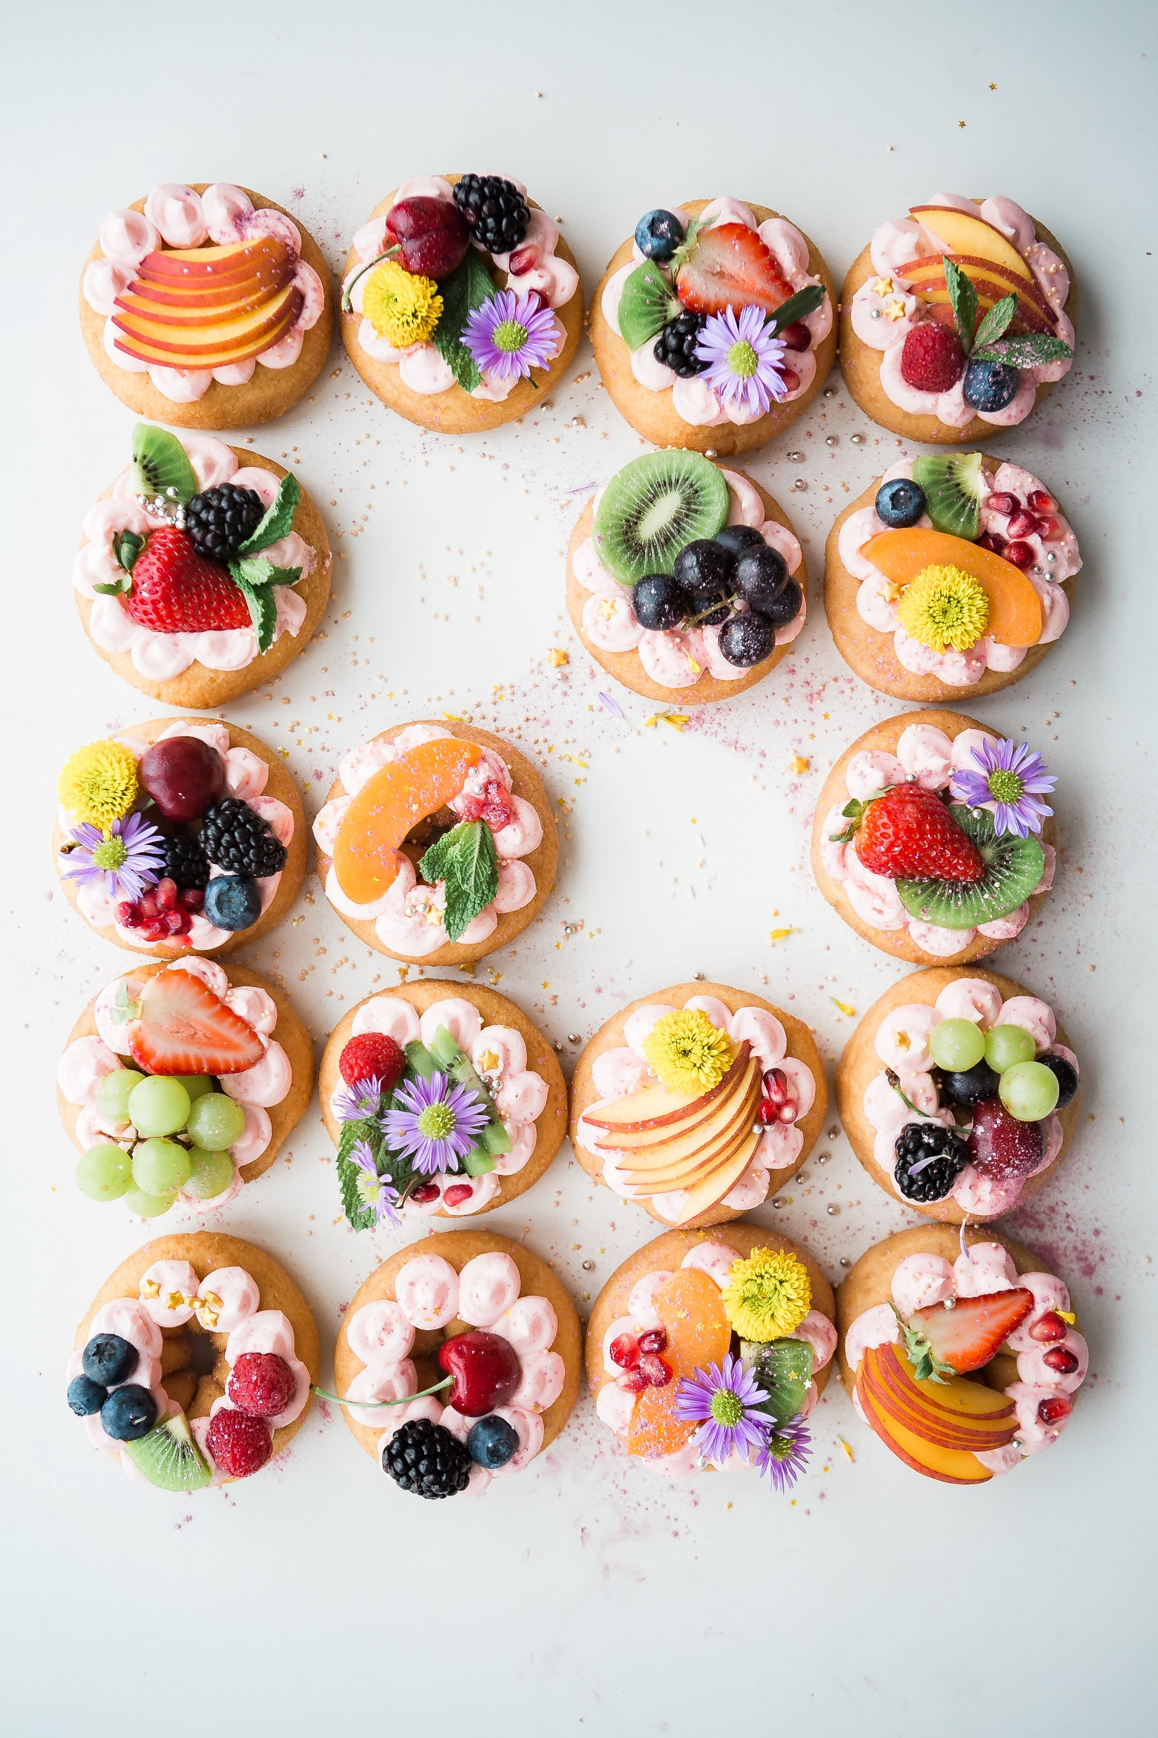

Food for Thought
A Convolutional Neural Network application for Food Image classification
Image: Brooke Lark - unsplash

Slide 2
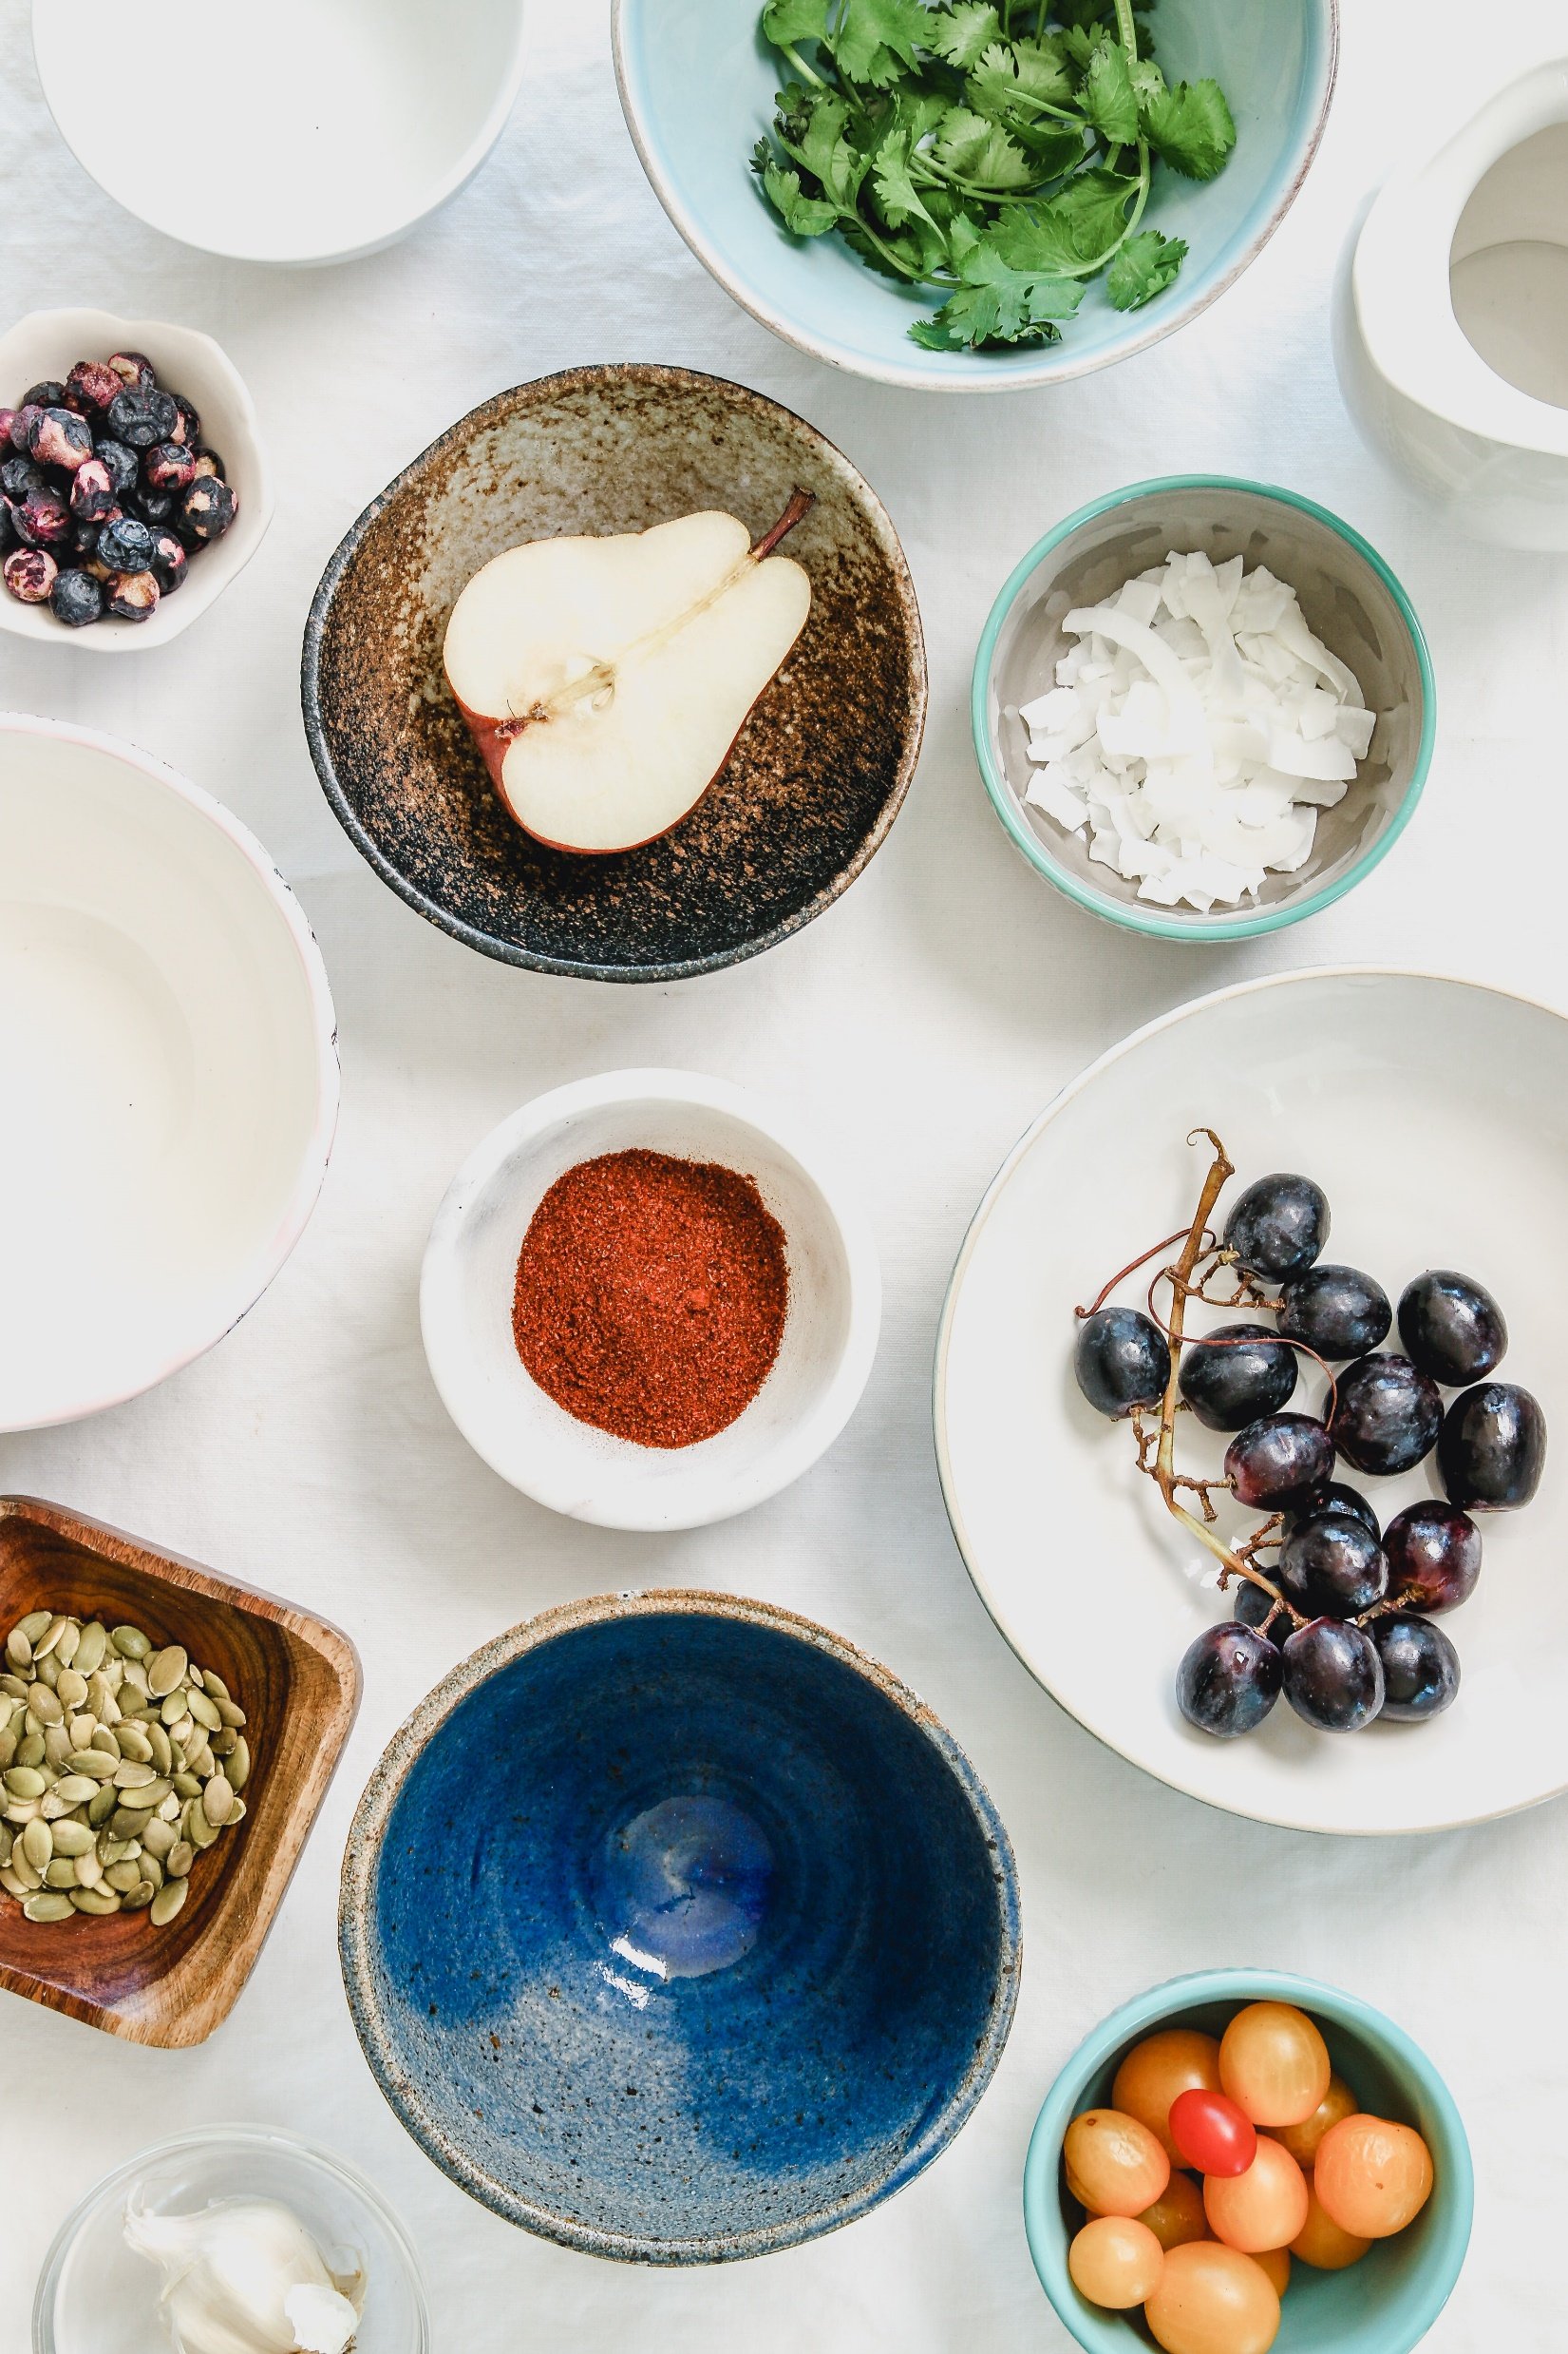
Food for Thought
A Convolutional Neural Network application for Food Image classification
Image: Joanie Simon - unsplash

Slide 3
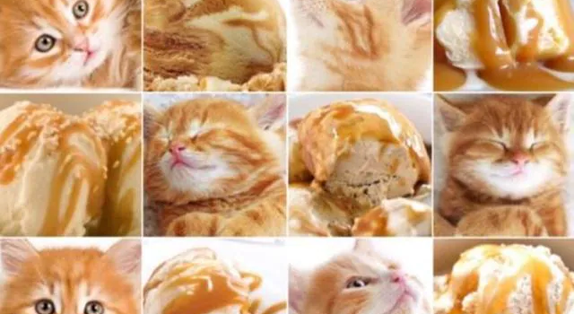
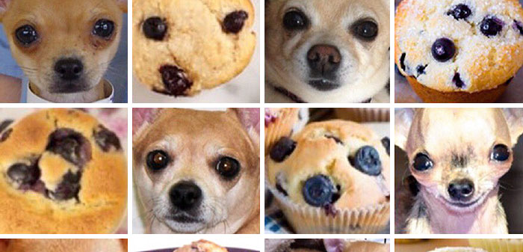
Food for Thought
A Convolutional Neural Network application for Food Image classification

Slide 4
Summary of the project
List the group members
Introduce the problem you are trying to solve
Show an analysis of the available data
Describe your solution
Comment positive and negative results of your solution (rely on quantitative and qualitative observations)
6. Describe alternative (possibly failed) experiments

Slide 5
Summary of the project
List the group members
- Alessandro Maccario (Badge number: 865682)

Slide 6
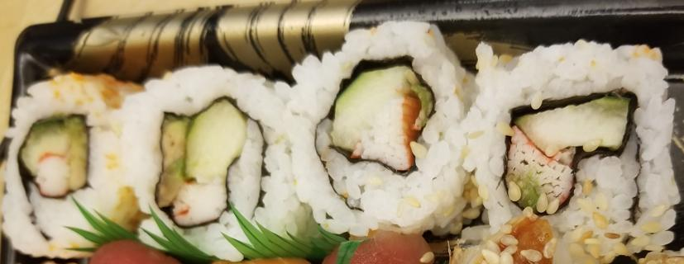
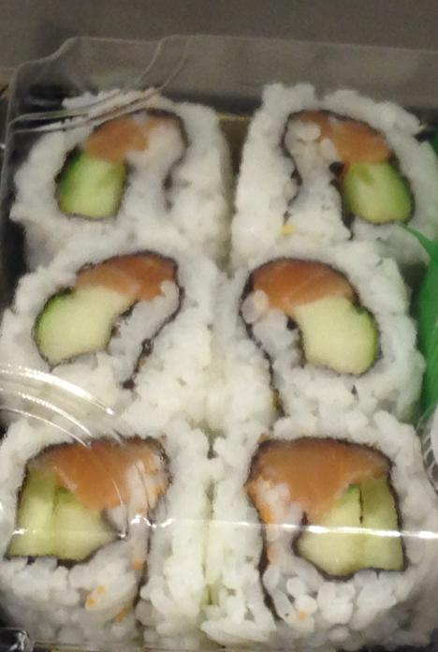
Remember:
- each slide max 3 points to show. The rest will be said out loud but in this case you can just put all the comments down below in the notes!
Introduction to the problem
Image Food classification is the process of identifying the type of food contained in an image. It is a challenging problem due to the wide variety of food items that exist and the variations that can occur within each type of food. Deep neural networks have proven to be effective for solving a variety of image classification tasks, including food classification.
CNN are particularly well-suited for image classification tasks because they can learn features from images and identify patterns and characteristics that are relevant for classification;
One of the problem encountered in this specific project is that for some categories (sushi and sashimi, for instance) the features to be learned are similar to each other and therefore is not simple, even for a human, to be able to distinguish those two types of food.
sushi
sashimi
Notes:
A food classification problem in Deep Learning is a type of problem where the goal is to accurately classify food items into predefined categories. This might involve categorizing different types of fruits, vegetables, meats, or other types of food into specific classes.
To solve it, you would typically start by collecting a large dataset of images or other types of data that represent different types of food. In this specific project it will be used the Example Food Images data set that contains 978 photographs of food in nine classes.
The literature suggests to use a Convolutional Neural Network (CNN) Deep Learning architecture in order to recognize and classify different types of food based on the input data, because they are particularly well-suited for image classification tasks. This is because CNNs are designed to automatically learn features from images and identify patterns and characteristics that are relevant for classification.
Once the model has been trained, it can then be use it to classify new images or other types of data and predict which class each food item belongs to.
This output can be useful in a variety of applications, such as creating a food recognition app that helps people identify different types of food, or developing a system that can automatically sort and organize food items in a warehouse or grocery store.

Slide 7
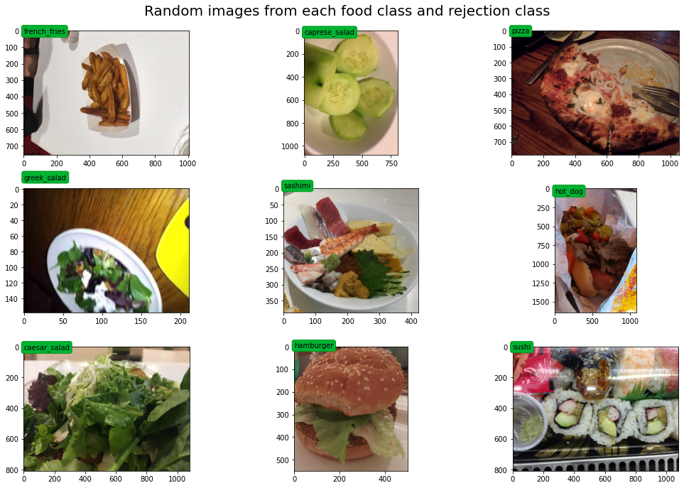
Remember:
- each slide max 3 points to show. The rest will be said out loud but in this case you can just put all the comments down below in the notes!
Show an analysis of the available data
In this picture it is possible to see different food classes for the problem at hand. The pictures present are also in different shapes, for instance:
french_fries: (756, 1008, 3)
caprese_salad: (1078, 808, 3)
pizza: (782, 1056, 3)
greek_salad: (159, 212, 3)
sashimi: (389, 422, 3)
hot_dog: (1650, 1081, 3)
caesar_salad: (808, 1078, 3)
hamburger: (549, 502, 3)
sushi: (808, 1078, 3)
Before feeding them into the models, the preprocessing procedure involves a resizing of the images.

Slide 8
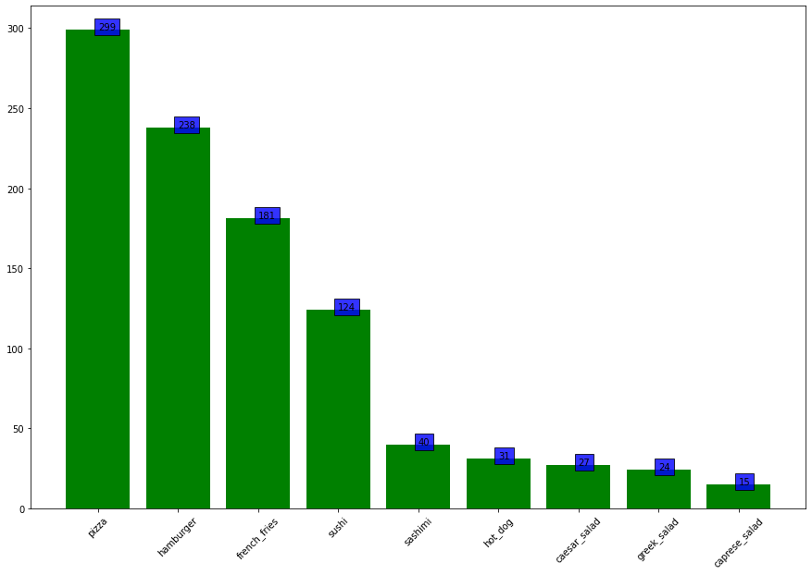
Remember:
- each slide max 3 points to show. The rest will be said out loud but in this case you can just put all the comments down below in the notes!
Show an analysis of the available data
The available data is divided in 9 different categories, such as pizza, hamburger, sushi.
The problem itself is an unbalanced problem, that is the number of examples in different classes is not equal. The model in this case can have difficulties to learn the classes with fewer data points.
In order to overcome the previous challenge, a data augmentation method has been considered in order to create sligtly different copies of the data right after separating the data in training, testing and validation folders. The training folder has been augmented reaching 200 images for each classes, before feeding the data to the model. The augmentation procedure involved horizontal and vertical flipping, brightness and hue modification.

Slide 9
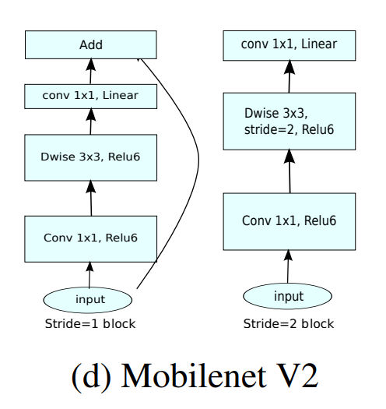
Remember:
- each slide max 3 points to show. The rest will be said out loud but in this case you can just put all the comments down below in the notes!
Describe your solution (MobileNetV2)
The solution involved the usage of the MobileNetV2 (1) architecture pretrained on the Imagenet dataset (2) in order to use the concept of Transfer Learning to apply the features learned by the model on another, bigger, dataset, on the one available in this project.
MobileNetV2 is a convolutional neural network (CNN), lightweight model that is well-suited for mobile and embedded applications, and can run efficiently on devices with limited computational resources.
AGGIUNGERE ALTRO QUI COME COMMENTO PER QUANDO PARLI!
Architecture
https://arxiv.org/pdf/1801.04381v4.pdf
https://www.image-net.org/

Slide 10
Remember:
- each slide max 3 points to show. The rest will be said out loud but in this case you can just put all the comments down below in the notes!
Describe your solution (MobileNetV2)
Different models have been trained in this project: custom models in order to try out how one can create created them from scratch. Performances have increased from the first model (around 40%) to more than 60% in the last model before the transfer learning section;
Other models have also been trained (VGG16, ResNet50), but from the accuracy metric point of view, only MobileNetV2 has been able to outperform the other models in only 20 epochs reaching over 92% accuracy both for the accuracy on the training set and validation set.
The results from the accuracy measures are very good, but on the inference data the model performs really poor
metti immagine con valori accuracy nel training e poi nell’inference il dataset finale con le classi in comparazione e il valore della percentuale di accuracy

Slide 11
Remember:
- each slide max 3 points to show. The rest will be said out loud but in this case you can just put all the comments down below in the notes!
Comment positive and negative results of your solution
(rely on quantitative and qualitative observations)

Slide 12
Remember:
- each slide max 3 points to show. The rest will be said out loud but in this case you can just put all the comments down below in the notes!
Comment positive and negative results of your solution
(rely on quantitative and qualitative observations)

Slide 13
Remember:
- each slide max 3 points to show. The rest will be said out loud but in this case you can just put all the comments down below in the notes!
Describe alternative (possibly failed) experiments

Slide 14
State-of-the-art
Paper da citare e da inserire in references:
https://link.springer.com/content/pdf/10.1007/978-3-319-23222-5_41.pdf
http://madima.org/wp-content/uploads/2017/11/12-A0-ICIAP-foodCNN-poster.pdf
https://boa.unimib.it/bitstream/10281/206401/4/CNN-based%20features_post-print.pdf
https://ieeexplore.ieee.org/stamp/stamp.jsp?tp=&arnumber=8228338
https://ieeexplore.ieee.org/stamp/stamp.jsp?tp=&arnumber=8550005
https://arxiv.org/pdf/1612.00983.pdf
https://www.irjet.net/archives/V9/i3/IRJET-V9I3368.pdf
https://www.irjet.net/archives/V9/i1/IRJET-V9I131.pdf

Slide 15
Dataset description
The Example Food Images data set contains 978 photographs of food in nine classes (caesar_salad, caprese_salad, french_fries, greek_salad, hamburger, hot_dog, pizza, sashimi, and sushi).
The size of the data set is about 77 MB.
https://de.mathworks.com/help/deeplearning/ug/data-sets-for-deep-learning.html

Slide 16
Models

Slide 17
Comments

Slide 18
To consider:
https://github.com/Murgio/Food-Recipe-CNN
Try using this also other than MobileNetV2:
https://www.kaggle.com/code/themlphdstudent/food-classification-using-inceptionv3
Altri esempi:
https://medium.com/analytics-vidhya/indian-food-image-classification-using-transfer-learning-b8878187ddd1
This is also very interesting:
https://github.com/abhijeet3922/Food-Classification-Task-Transfer-learning/blob/master/Food_classification_transfer_learning_finetuningVGG16_30072019.ipynb

Slide 19
References:
DATASET:
https://de.mathworks.com/help/deeplearning/ug/data-sets-for-deep-learning.html

